Slide 1
De&I Workshop: Casing basics
Sign in here! bit.ly/180dccyc

Slide 2
agenda
Get To Know Our Organizations!
Diversity and Inclusion
An Intro to Recruiting
What is Casing?
Market Sizing for Dummies
Case Workshop
Questions?
Notes:
180dc

Slide 3
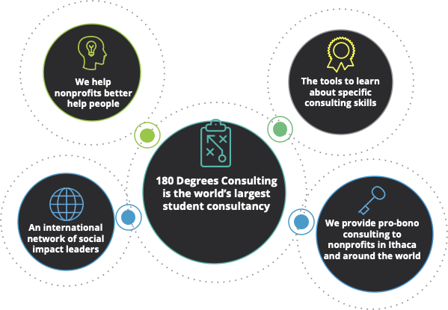
180DC intro
Who We Are:
Our Organization:
Our Values:
We are the Cornell Branch of 180Degrees Consulting!
This is what we do-
Consult exclusively for non-profits our global network gives us access to organizations from across the world! Much of our work revolves around digital marketing, funding, and facilitating connections and collaborations
Foster a supporting community of diverse, creative, and social impact orientated-students
We're looking for new members! Apply by 9pm on 9/17/2021. You can find our application on our Facebook (180 Degrees Consulting Cornell) or Instagram (@Cornell180DC)
Because of the variety of organizations we work with- we're looking for the unique perspectives YOU can bring.
Diversity
Integrity
Collaboration
Passion
Social Impact
Notes:
180DC at Cornell provides high-quality consulting services to socially conscious businesses and non-profits in the Ithaca community and beyond to produce innovative and lasting results.
Mikayla

Slide 4
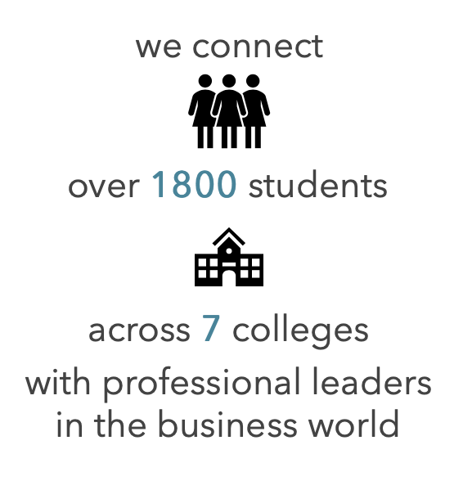
SWIB Intro
The largest undergraduate business organization for women at Cornell
We empower members to develop personally and professionally through education and experience
SWIB mentorship program
Host networking events with firms across many industries
https://www.cornellswib.com
Emerging Leaders Program
50 Analysts gain industry knowledge, technical expertise, and teamwork skills
10 Associates lead projects using prior ELP experience
Professional development workshops, exclusive networking events, and the opportunity to apply for an E-Board position
Past projects
IB: Lululemon's Acquisition of Mirror
S&T: Square Stock Pitch
Consulting: Restoring Consumer Confidence in Rideshare Services
Marketing: Dunkin Donuts & Charlie D'Amelio Collab
Real Estate: Impact of Covid-19 on Hotels
ELP application due:
9/19 at 11:59 PM EST
Interviews:
9/22 - 9/25

Slide 5
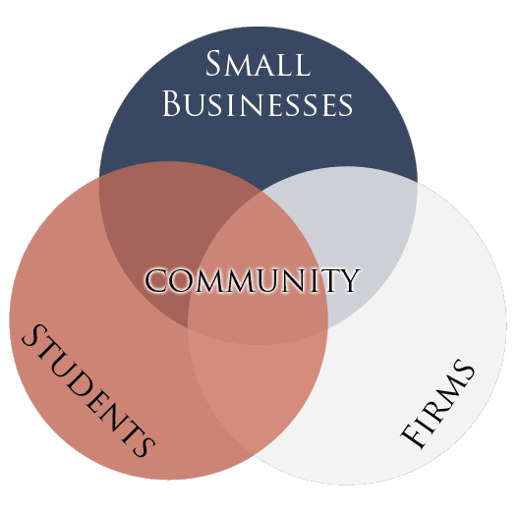
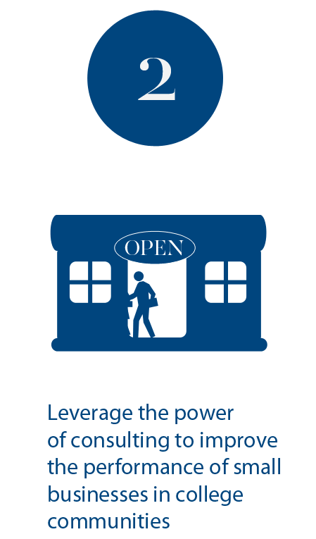
CyC intro
Consult Your Community provides pro bono consulting services to low-income, minority, and women small business owners in college communities.
Mobilize a network of college students form America’s top universities.
Leverage the power of consulting to improve the performance of small businesses in college communities
Revitalize, strengthen, and grow our nation from the bottom up
A model based on
joint value creation
Notes:
cyc

Slide 6
Recruiting as an urm
When networking at PWIs, there’s a common experience to feel isolated when there are certain topics of conversation that just don’t apply to students that have had little exposure and access to those types of financial, social, and/or knowledge capital
Ways to mitigate feelings of isolation
building allyship with your fellow students (going through the process + networking together)
asking about D&I initiatives at these orgs during networking rounds/interviews
finding club members that understand your lived experiences and can advocate for you
Highly Recommended:
Info Sessions
Coffee Chats
Notes:
cyc

Slide 7
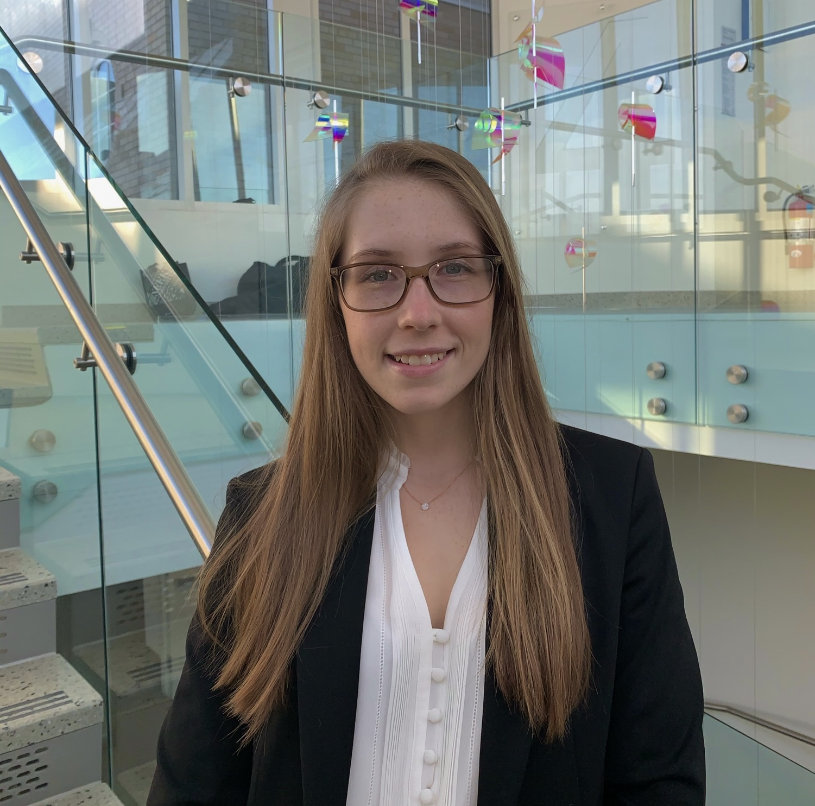
advice from a WoMAN in the consulting industry
1
Education
Start!
Applied Economics & Management,
Strategy and Entrepreneurship
2
Internship
Realize your value
Hobbies/Interests
3
Don't be afraid to stand out; that's why people will remember you!
Emily Boldt
Fitness, equestrian, public policy, agriculture
Notes:
swib

Slide 8
Before you learn casing…
How does your resume look?
Are you comfortable with behavioral questions?
Notes:
swib

Slide 9
Resume review
Formatting
Keep the format you use consistent throughout the resume.
This includes the same font, the same line spacing, and the same kind of bullets used.
Explanations
Each bullet should have information of what you did, how you did it, and the results.
You should be able to speak on each bullet point confidently if asked in an interview.
Structure
Preferably divide it into different sections.
The sections could be: Education, Professional Experiences, Clubs, Skills.
Other
A part not given enough importance are your skills; they help in making conversations!
Have at least 3 bullet points of everything on your resume.
Notes:
swib

Slide 10
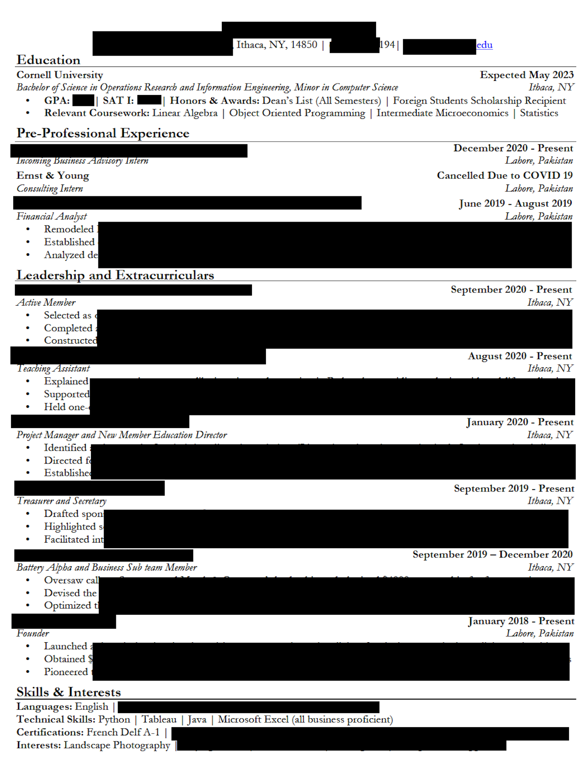
Resume review
4 Sections
Different words to start each sentence
Same font and bullets used
Numerous things mentioned in skills and interests
Notes:
swib

Slide 11
Behavioral questions
Opportunity to provide context to your resume and and focuses on how you handle different professional situations
STAR Method
Examples
Do’s
Don'ts
tell me about yourself
use a variety of different experiences + transferable skills
Keep answers to 1-2 mins
be specific – do your research
ask follow-up questions
lose your composure or confidence due to a slip-up
answer immediately if unsure; take time to think
act unprofessionally
why this organization
Notes:
swib

Slide 12
What is consulting?
Notes:
180dc samika

Slide 13
What is casing?
1. You’re presented with a business situation and/or problem
2. You create a structured approach to the problem
3. You perform analysis with given data
Case interviews are usually 30-45min in length in a formal recruitment setting.
4. You brainstorm strategies based on the interviewer’s questions
5. You present your conclusions
Tip: always keep a pen and paper with you for a case interview!

Slide 14
Why case?
Practicing casing helps strengthen your communication and analytical abilities.
What do interviewers look for when evaluating you?
Structured thinking
Analysis + data crunching abilities
Communication + synthesis abilities
Group interviews: your ability to work with a team and present your findings
It’s not always about finding the “correct answer!”
Notes:
It's not about finding an exact correct answer
Practicing casing strengthens your communication and analytical abilities
Interviewers want to see
Your structured thinking
Your ability to analyze and work with data
To communicate your thoughts/analysis
Synthesize your findings
In a group case setting: demonstrates your ability to work in a team/professional environment, while applying the above skills

Slide 15
The approach
Step 1: Define the problem
Listen closely
Take notes on what’s important
Case source: UC Berkeley Haas casebook ‘06, “Disaster Remediation”
Important information:
Who is the client?
What does the client do?
Who does the client provide for? (i.e. customers)
What is the question/issue?
Clarifying information
Ask clarifying questions

Slide 16
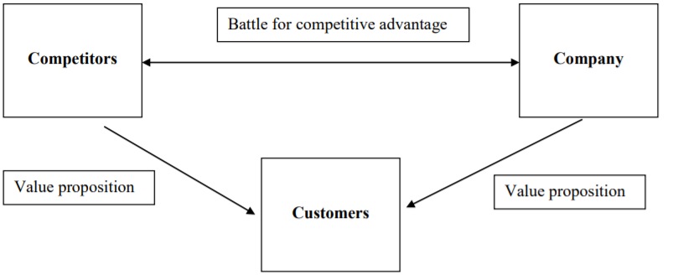
A Note on frameworks
Step 2: Structure analysis
Profitability Framework
Ask for time to create your framework
4 P’s Marketing Framework
Come up with 3-4 categories (buckets)
MECE (mutually exclusive, collectively exhaustive)
3 C’s Strategy Framework
Practice creating + presenting

Slide 17
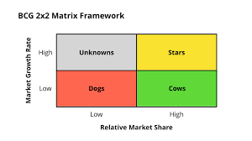
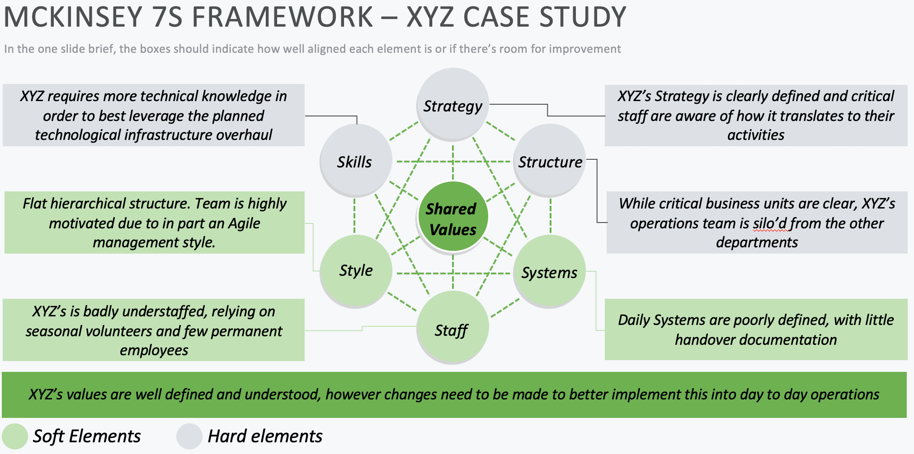
Additional types of cases

Slide 18
The approach
Step 3: Gather needed data
Tell your interviewer what you observe about the graph
Talk through key points of graph
What can you conclude?

Slide 19
The approach
Step 4: Conduct analysis + provide insights
Analysis Question: Based on your analysis, what strategies would you suggest?
1
2
3
What did you conclude from the data/the math?
How can you address the initial question?
What creative insight can you offer? + risks/mitigation

Slide 20
The approach
Step 5: Conclude case
You enter an elevator and the CEO is already there! You are asked to provide a quick update on your progress.
State your main argument.
Mention any important analysis.
Briefly describe any strategies you came up with.
Implementation (i.e. Significant risks/mitigation, timeline)
Conclude

Slide 21
Market sizing
What is market sizing?
Making an estimate about a size of something with little or no information
Examples Process
Estimate the demand for yoga classes in the US.
How many tennis balls could fit in this room?
How many Starbucks stores are there on Manhattan?
1. Ask clarifying questions
2. Break down pieces
3. Make calculated assumptions
4. Estimate and consolidate
Notes:
180dc alan

Slide 22
MARKET SIZING EXAMPLE
What is the market size for coffee in NYC?
Coffee Market Size
Number of cups per year
# of people
# of cups / person / year
Price per cup
# weeks per year
# of cups per person per week
Break down
8m
400m
50
1.6 billion
50
$4
1
Calculate

Slide 23
Big Yellow bus co (BYB)
Your client is a private equity fund considering the acquisition of Big Yellow Bus Co (BYB), one of the leading manufacturers of school buses in the US. It is the #1 player in the market by revenue, #2 by volume. There are only 3 competitors in the market with relatively equal share but BYB was the clear leader 5 years ago. What are some considerations for our client before making an investment decision?
Notes:
Cyc grace, Example case + framework (use audience participation !!)

Slide 24
Big Yellow bus co (BYB)
What are some considerations for our client before making an investment decision?
Notes:
Example case + framework (use audience participation !!)

Slide 25
Big Yellow bus co (BYB)
How large is the market for school buses in the US? Is this market attractive?
Notes:
Example case + framework (use audience participation !!)

Slide 26
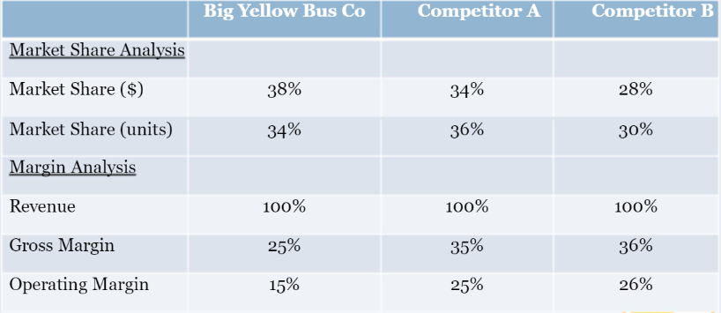
Big Yellow bus co (BYB)
Now let's transition from looking at the market to looking at specifics. Here is some information about how BYB compares to its competitors. What do you notice?
Notes:
Example case + framework (use audience participation !!)

Slide 27
Big Yellow bus co (BYB)
What are some ideas to help them lower their gross margins?
Notes:
Example case + framework (use audience participation !!)

Slide 28
Big Yellow bus co (BYB)
The CEO of the private equity firm is waiting in the board room for your recommendation on whether or not to proceed with this acquisition! What will you say?
Notes:
Example case + framework (use audience participation !!)

Slide 29
Big Yellow bus co (BYB)
What does a good recommendation look like?
Relates back to question
Gives recommendation upfront
Quantifies recommendation
Highlights next steps and risks
Notes:
Example case + framework (use audience participation !!)

Slide 30
Casing Do’s and Do not’s
DO
DO NOT
Practice, practice, practice!
Ask categorized questions
Let the interviewer help you
Provide and connect insights
Check in with the interviewer
Wait until the last minute
Play 20 questions
Dig your heels in
Get frustrated
Be afraid to start
Great answers link analyses back to the problem with creative insights
Notes:
cyc

Slide 31
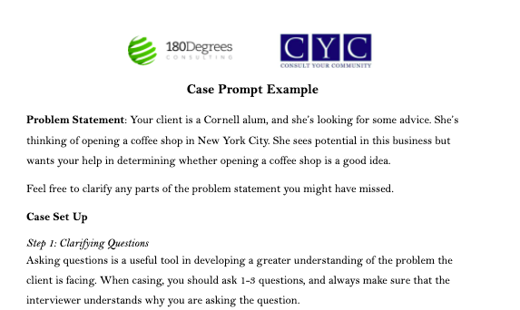
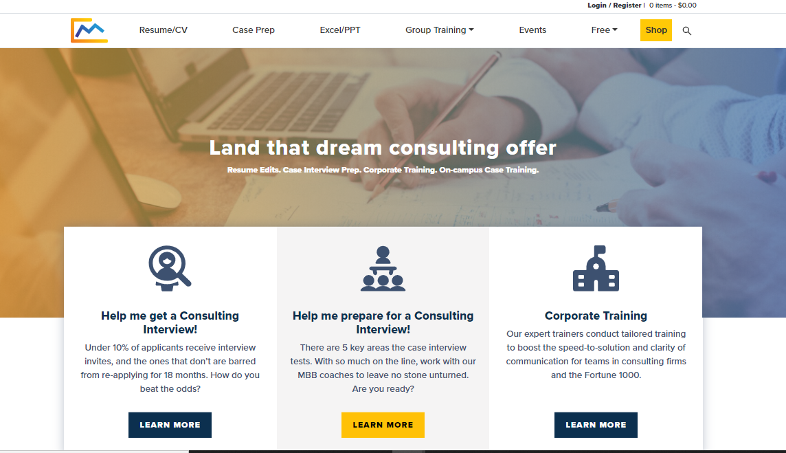
Resources
Management Consulted
Case Prompt Example
Management Consulted
Affinity Orgs
Notes:
Yuan

Slide 32
Questions?
Thank you for coming!
Sign in here! bit.ly/180dccyc

Slide 33
CONTACT us!
180Degrees
Alan Wo (D&I Chair) ayw35@cornell.edu
Samika Kulkarni (D&I Chair) sbk86@cornell.edu
Sherri Kim (Graphics Chair) sk2396@cornell.edu
Consult Your Community
Kenny Wong (President) kzw7@cornell.edu
Grace Zhang (Director of Recruitment) gxz2@cornell.edu
Athean Myat (Engagement Manager) mm2595@cornell.edu
SWIB
Elena Ault (VP of Diversity, Equity, and Inclusion)
ea363@cornell.edu

