Slide 1
SWIB x CIBC interview skills workshop
February 5th 2022

Slide 2
Agenda
Club Intros + Recruitment
Behavioural Interview Explanation
Networking Session
Open Q&A

Slide 3
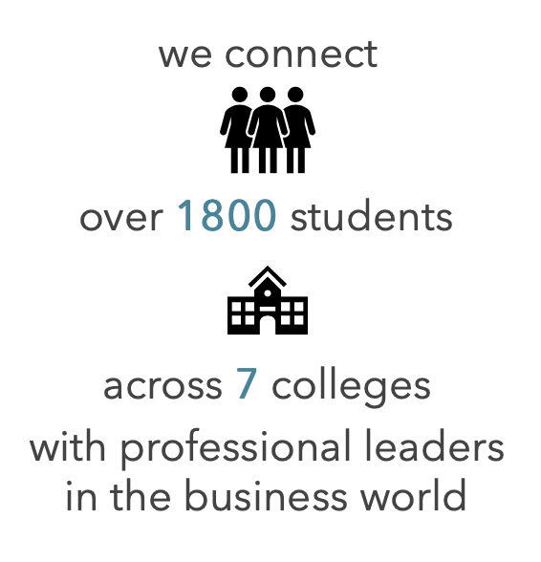
Society for women in business
The largest undergraduate business organization for women at Cornell
We empower members to develop personally and professionally through education and experience
SWIB mentorship program
Host networking events with firms across many industries
https://www.cornellswib.com
Emerging Leaders Program
50 Analysts gain industry knowledge, technical expertise, and teamwork skills
10 Associates lead projects using prior ELP experience
Professional development workshops, exclusive networking events, and the opportunity to apply for an E-Board position
Past projects
IB: Lululemon's Acquisition of Mirror
S&T: Square Stock Pitch
Consulting: Impact of Covid-19 on Hospitality Industry
Marketing: Dunkin Donuts & Charlie D'Amelio Collab
ELP application due:
2/24 at 11:59 PM EST
Interviews:
Week of 2/28

Slide 4
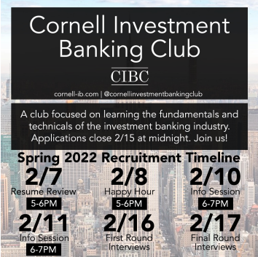
Cornell Investment Banking Club
Cornell’s premier finance club with a specific focus on investment banking and recruitment preparation
Active learning through group project immersion, professional development, and NME
Variety of resources (weekly newsletters, coffee chat programs, mock interviews, mentorship program, guest speakers)
General Body Meetings:
Every Tuesday 7-8pm EST
Industry Group Meetings:
TBD by Project Manager
NME:
Every Sunday 1-3pm EST
E-Board Office Hours:
Directly after G-Body

Slide 5
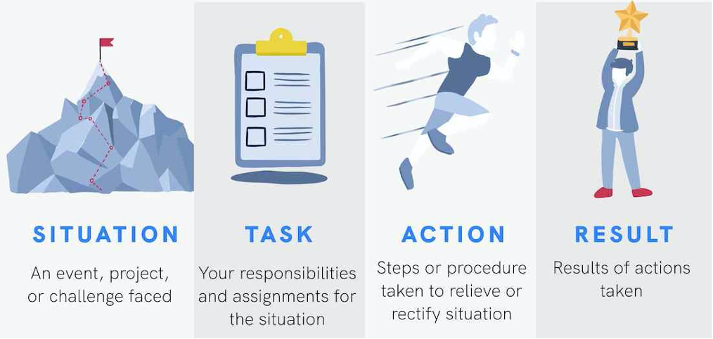
The behavioural interview
Opportunity to provide context to your resume and focuses on how you handle different professional situations
STAR Method
Do’s:
Use a variety of different experiences + transferrable skills
Keep your answers to 1-2 mins
Be specific & do your research
Ask follow-up questions
Don’ts:
Lose your compsure or confidence due to a slip-up
Answer immediately if usure, take your time to think
Act unprofessionally
Notes:
What is it
Typical questions
Purpose of the interview (what is the employer trying to learn?)
Resume, cover letter, interviews all projecting the same character/story

Slide 6
Common behavioral questions (STAR)
Team-based
Tell me about a time you worked in a team
Tell me about a time you had a disagreement with a team member. What did you do about it?
Personal
Tell me about a time you overcame a challenge
Tell me about a time you had to work under pressure
Strengths / Weaknesses
3 strengths
3 weaknesses

Slide 7
Networking session
Breakout rooms are open, feel free to hop around!

Slide 8
Open q&a
Ask away!

Slide 9
Thank you for attending!
Please reach out to Divya at dr458@cornell.edu or Angela at ayl63@cornell.edu with questions, feedback, or anything else!

